Slide 1
Surveying And Reproducing MD5 Fast Collision Attack Algorithms
Hack Lab Presentation
Supervisor: Kaitai Liang
Meng Zheng
Electrical Engineering
M.Zheng-3@student.tudelft.nl
Yuhang Tian
Embedded System
Y.Tian-13@student.tudelft.nl
April 2021

Slide 2
Overview
X. Wang’s Attacking Scheme
V. Klima’s Attacking Scheme
Collision Resistance
M. Stevens’ Attacking
Scheme
Comparison

Slide 3
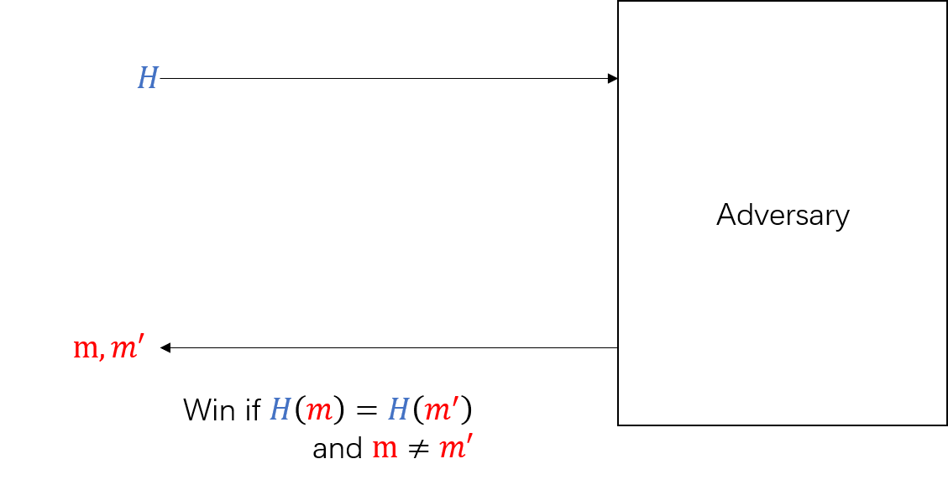
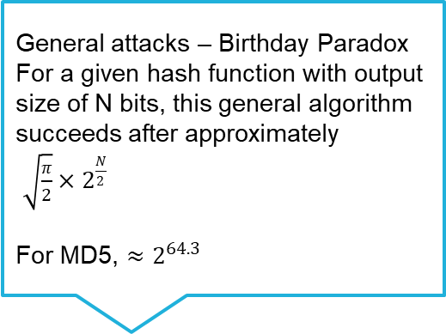
Collision Resistance & Collision Attack
General attacks – Birthday Paradox
For a given hash function with output size of N bits, this general algorithm succeeds after approximately
$\sqrt{\frac{π}{2}}×2^{\frac{N}{2}}$
For MD5, $≈2^{64.3}$
A hash function should have the collision resistance – it is infeasible to find two messages that have the identical hash values

Slide 4
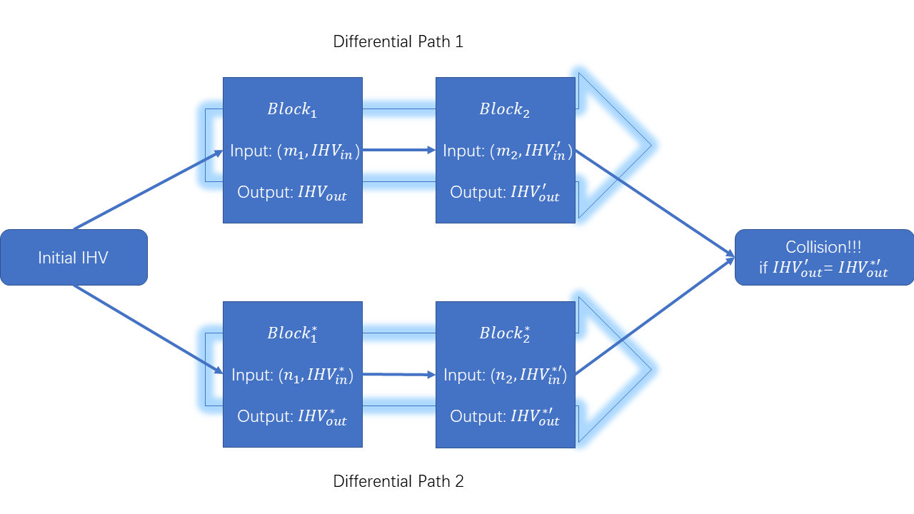
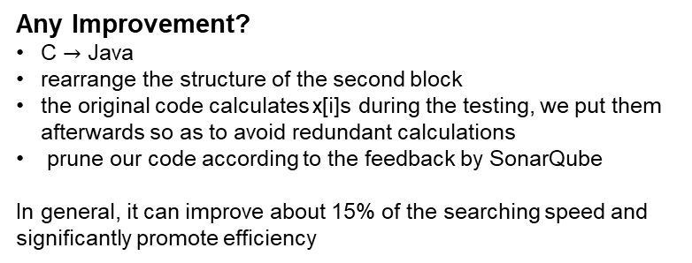
Wang’s Collision Attack – Differential Path & Message Modification
Message Modification:
When a certain condition in the second round fails, one can use message modification. This is a substitution formula specially made for this condition on the message block B. In the case that this condition does not hold applying this substitution has the effect that this condition now does hold without interfering with other previous conditions.
Any Improvement?
C $→$ Java
rearrange the structure of the second block
the original code calculates x[i]s during the testing, we put them afterwards so as to avoid redundant calculations
prune our code according to the feedback by SonarQube
In general, it can improve about 15% of the searching speed and significantly promote efficiency

Slide 6

Klima’s Collision Attack – Point of Verification (PoV) & Tunnels
The Deterministic and Probabilistic Tunnels
The modification is more flexible
Tunneling enables to fast collision searching and in some sense replace present multi-message modification methods considerably.
Any Improvement?
C $→$ Java
Pre-calculate masking bits to avoid using “mask_bit” function to generate them during looping
However, the improvement is not significant, since the speed is originally fast.

Slide 7
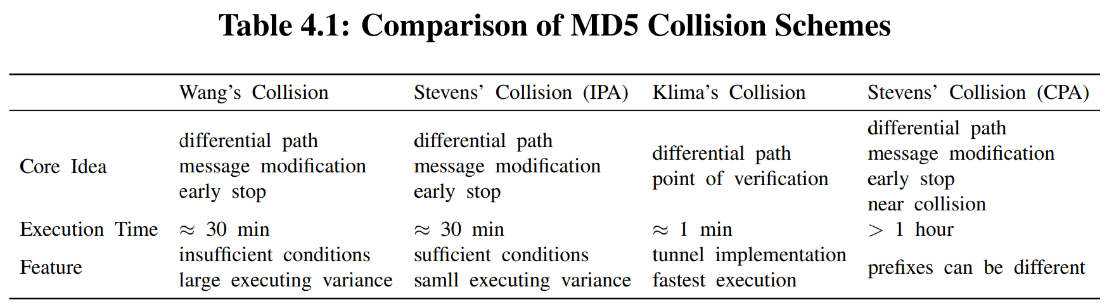
Comparison
Due to the insufficient conditions, Wang’s searching sometimes meaninglessly traverses Q[20], which adversely increases the worst-case execution time.
The searching time of Stevens’ attack tends to be more stable.
The fast algorithm to find a collision pair of MD5 is the one provided by Klima equipped with tunnels.
Stevens’ versions are fancy that can choose the prefix or even use a single block to obtain the collision, but the trade-off is spending more time.

Slide 8
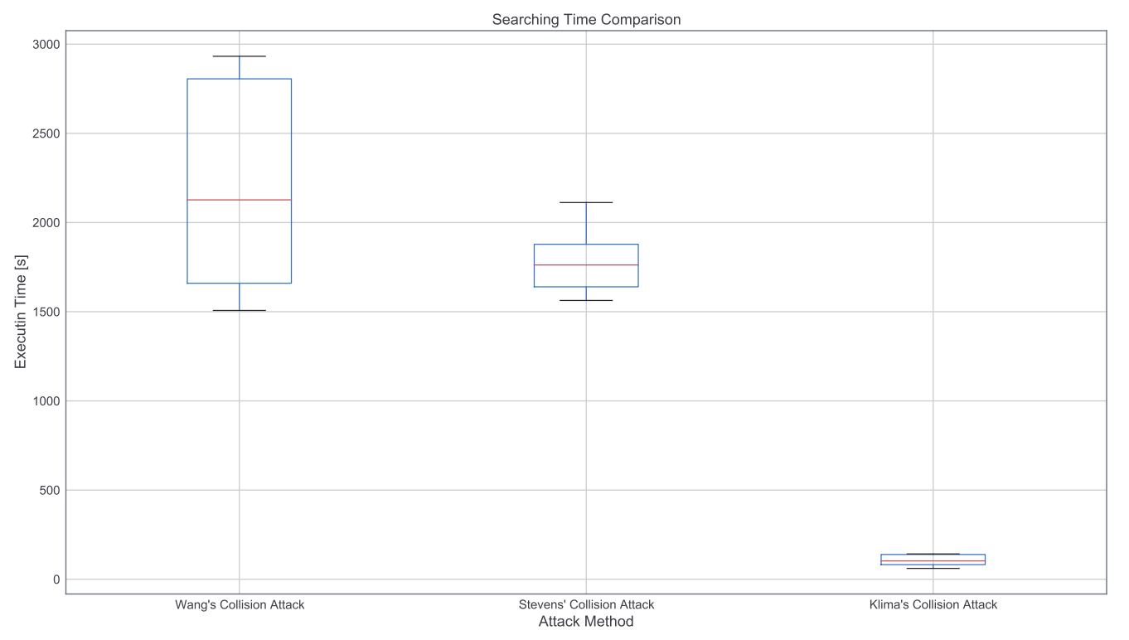
Comparison
Figure 4.1: Box-plot Comparison

Slide 9
Thanks for your listening!
Questions?
Project Website: https://github.com/Timo9Madrid7/MD5-Collision

Slide 10
Reference
Stevens, M., Lenstra, A. K., & De Weger, B. (2012). Chosen-prefix collisions for MD5 and applications. International Journal of Applied Cryptography, 2(4), 322-359.
Stevens, M. (2012). Attacks on hash functions and applications. Mathematical Institute, Faculty of Science, Leiden University, 3.
Stevens, M. (2006). Fast Collision Attack on MD5. IACR Cryptol. ePrint Arch., 2006, 104.
Wang, X., & Yu, H. (2005, May). How to break MD5 and other hash functions. In Annual international conference on the theory and applications of cryptographic techniques (pp. 19-35). Springer, Berlin, Heidelberg.
Klima, V. (2006). Tunnels in Hash Functions: MD5 Collisions Within a Minute. IACR Cryptol. ePrint Arch., 2006, 105.
Klima, V. (2005). Finding MD5 Collisions on a Notebook PC Using Multi-message Modifications. IACR Cryptol. ePrint Arch., 2005, 102.
Hawkes, P., Paddon, M., & Rose, G. G. (2004). Musings on the Wang et al. MD5 Collision. IACR Cryptol. ePrint Arch., 2004, 264.
Smart, N. P., & Smart, N. P. (2016). Cryptography made simple. Springer.
Mikle, O. (2004). Practical Attacks on Digital Signatures Using MD5 Message Digest. IACR Cryptol. ePrint Arch., 2004, 356.
Kaminsky, D. (2005). MD5 to be considered harmful someday. In Aggressive Network Self-Defense (pp. 323-337). Syngress.
Kashyap, N. D. (2006). A meaningful MD5 hash collision attack.

